Slide 1

Online Safety Awareness
for
Parents and Carers
Tuesday 7th January 2023
‘Anyone remember the good old’ days before Facebook, Instagram and Twitter? When you had to take a photo of your dinner, get the film developed, then go around to all of your friends’ houses to show them the picture of your dinner?’

Slide 2
Aims of the presentation?
What is a CEOP ambassador? (CEOP)
How children use the internet.
Positive aspects of being online
Managing Risks
Technologies your children might use –Gaming, Instant Messaging, Mobiles etc
Meta verse the good and bad
Parental Controls
Tips for protection
Advice and help (including useful websites)
Questions

Slide 3


CEOP is a command of the National Crime Agency (NCA).
CEOP is committed to tackling the sexual exploitation and abuse of children (CSEA), both online and offline.
A multi-disciplinary child protection agency.
Child-centred approach.

Slide 4


Slide 5
Why parents and carers need to talk and share with their children.
Please see video link attached seperately. (Whol’s Sam CEOP)

Slide 6
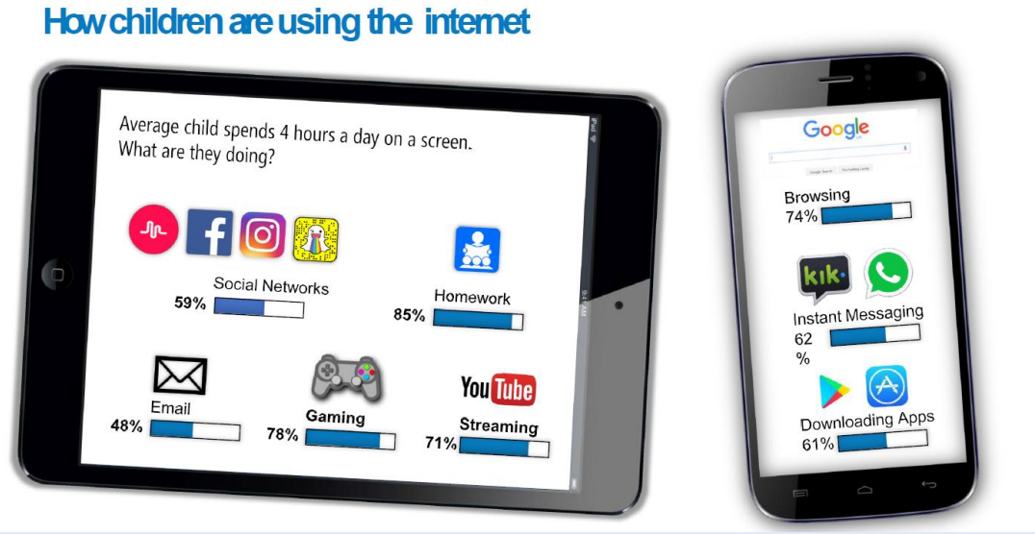

Slide 7
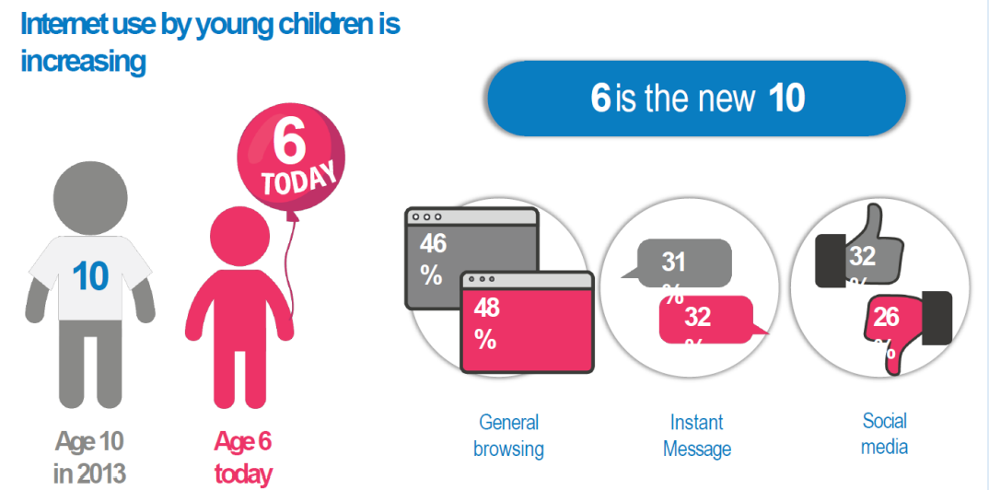

Slide 8
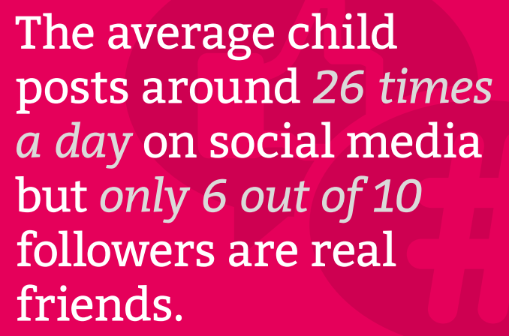
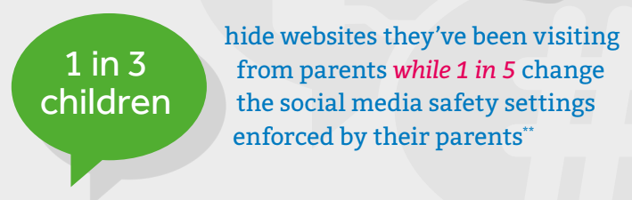
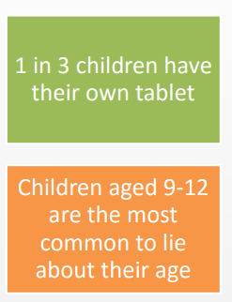
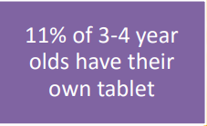
Quote from children’s commission 30th January 2023
By age nine, 10% had seen pornography, 27% had seen it by age 11 and half of children who had seen pornography had seen it by age 13.

Slide 9
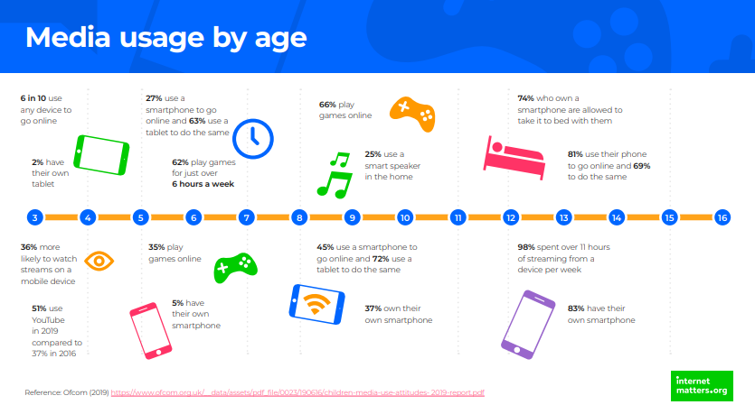

Slide 10
Websites
Which sites do your children use online?

Slide 11
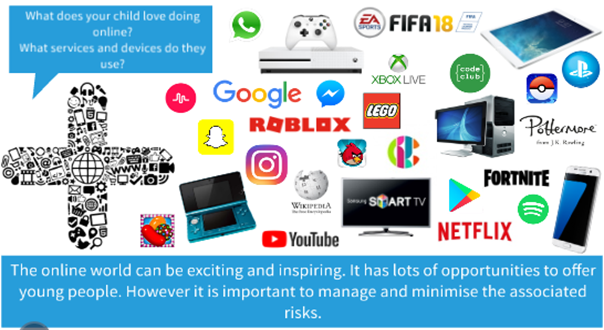
Websites

Slide 12
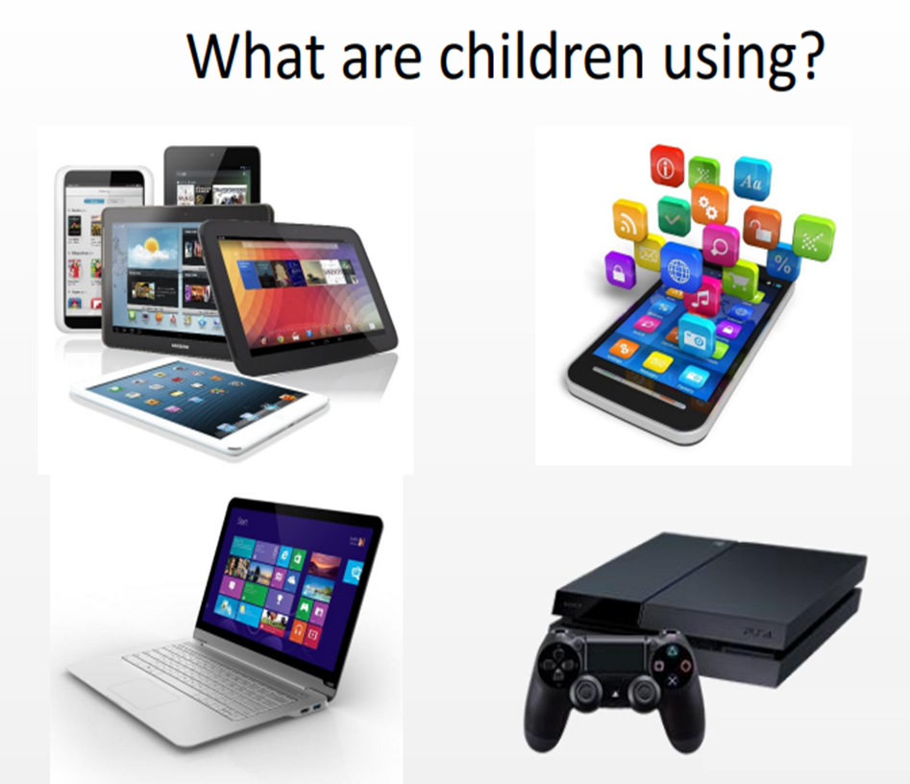
The online world
•Children are natives in the online world, most are unaware of life without:
–IPhone
–Games consoles
-VR Headsets
–Google
–Emails
messaging
–Facebook/whatsup/TikTok
•They feel confident using new sites and technologies, moving from site to site with ease.

Slide 13
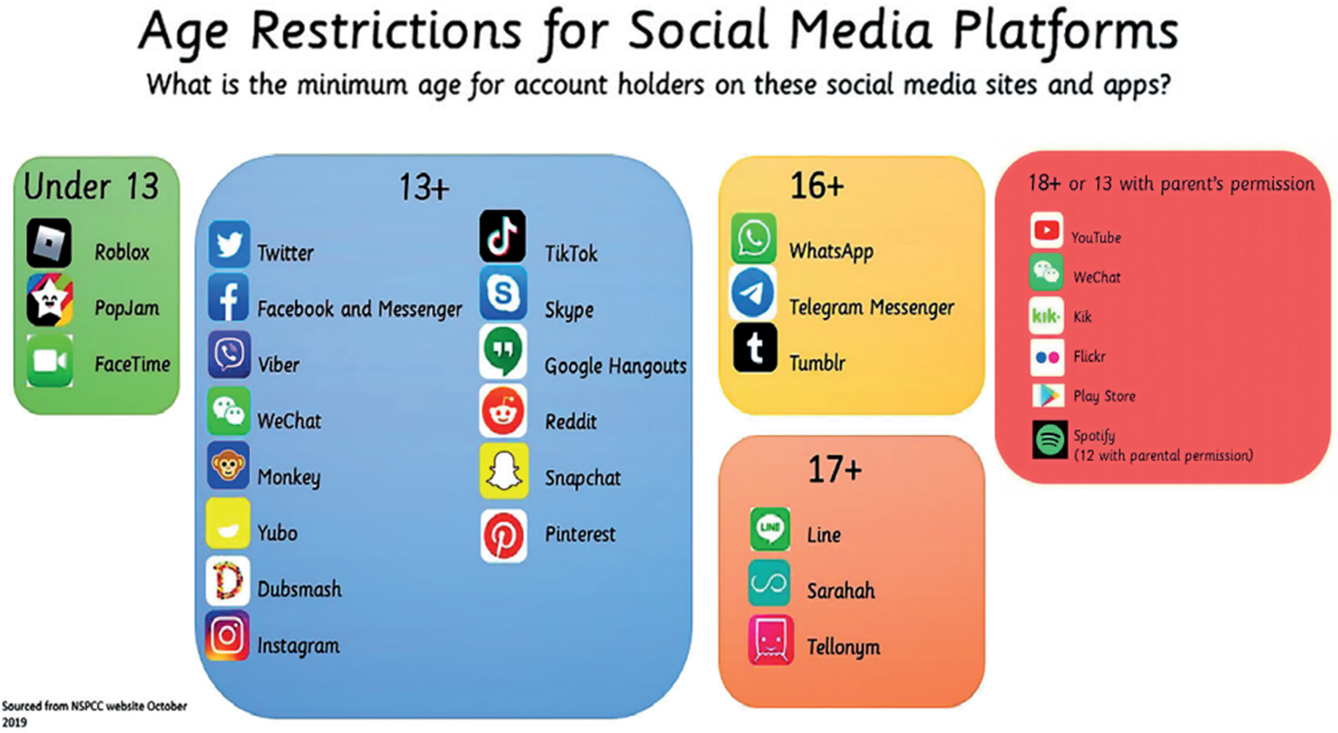
Age restrictions

Slide 14
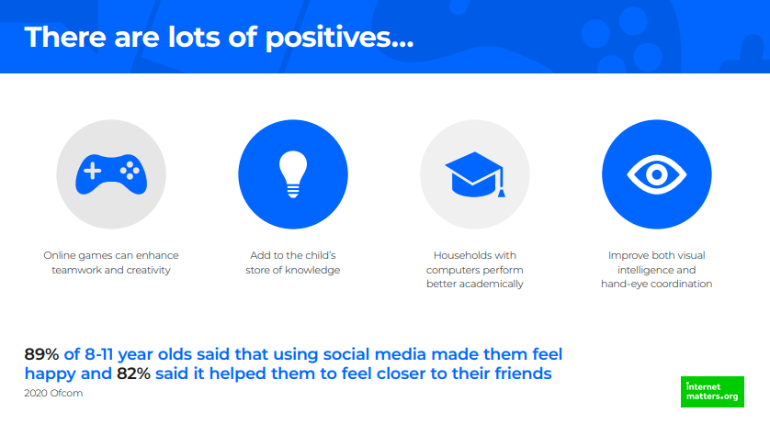

Slide 15


Slide 16
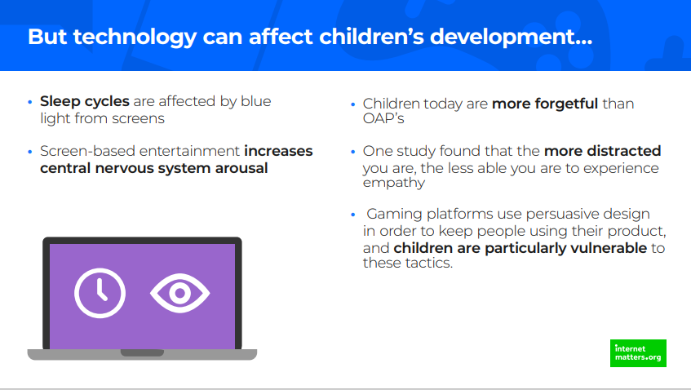

Slide 17
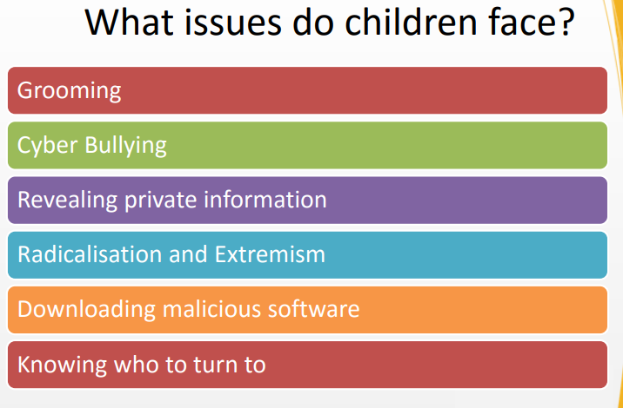
Websites

Slide 18
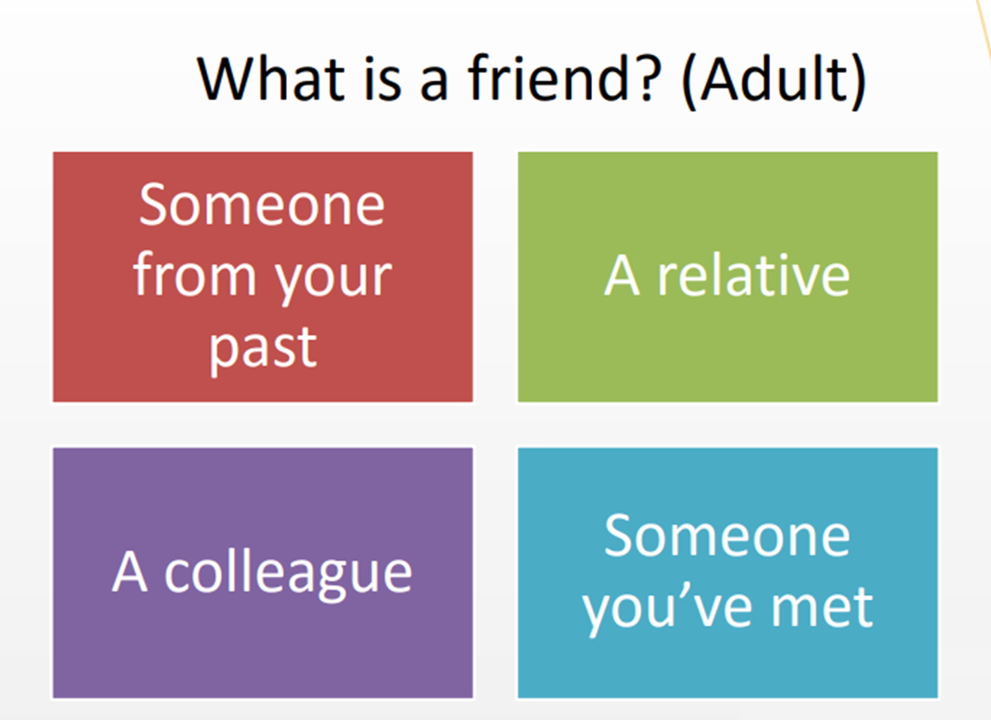
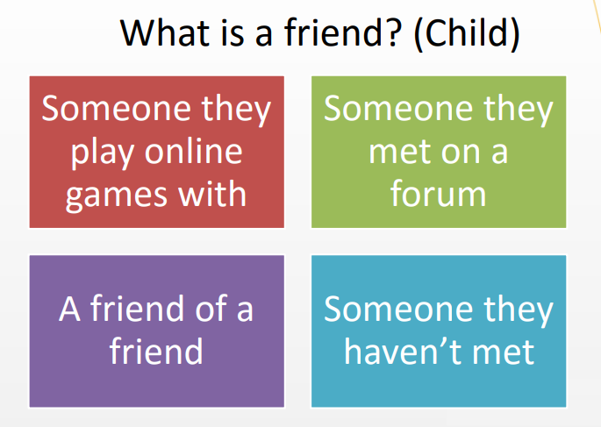
Friends

Slide 19
Webcam Risks
Caught in webcam risks.

Slide 20


Slide 21


Slide 22


Slide 23


Slide 24
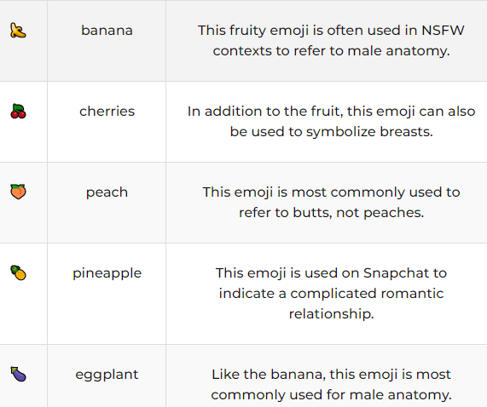
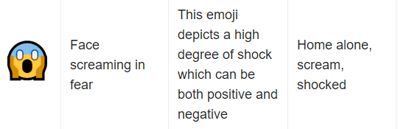
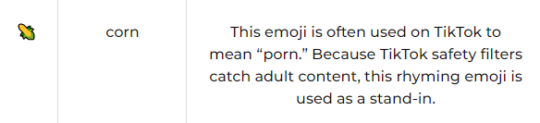
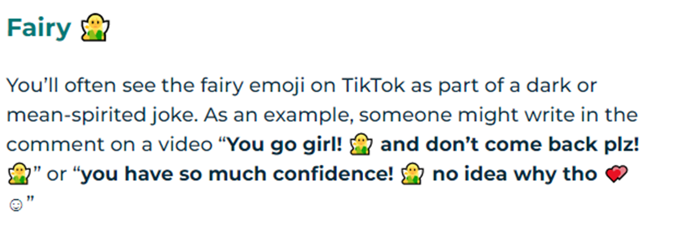

Emoji's are the new communication.

Slide 25
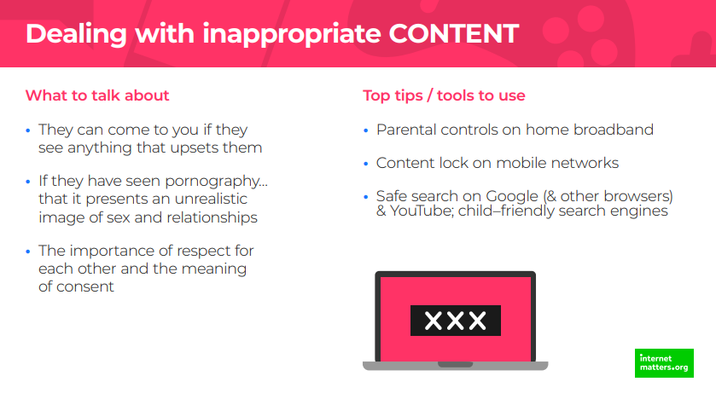

Slide 26
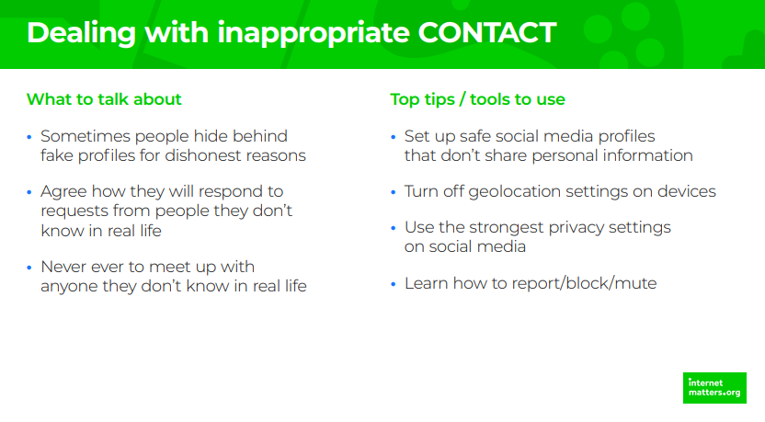

Slide 27
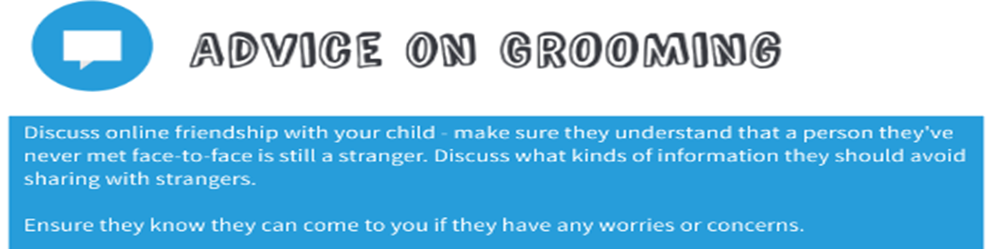

Slide 28
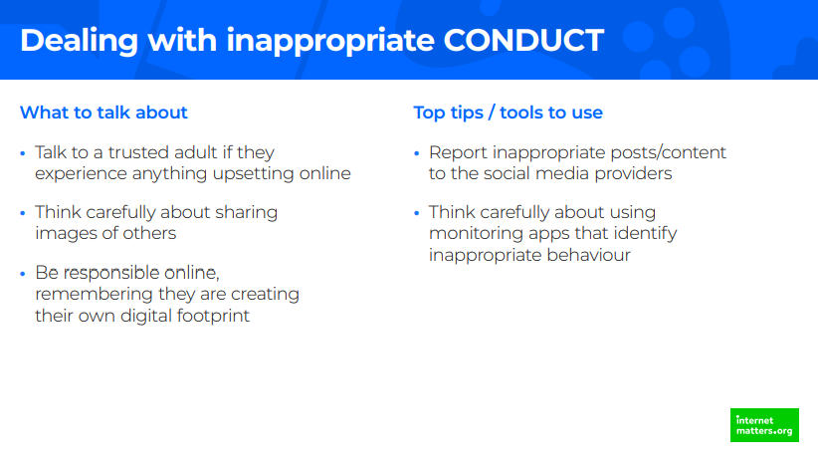

Slide 29
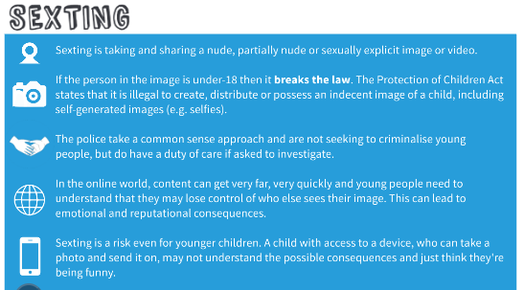

Slide 30
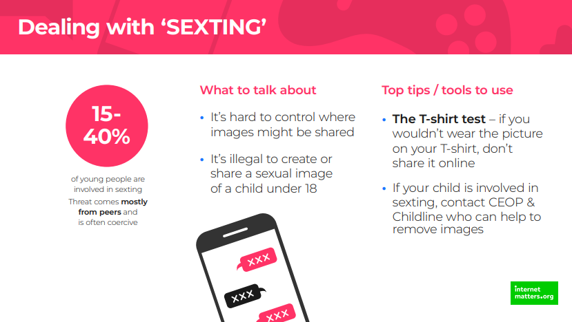

Slide 31
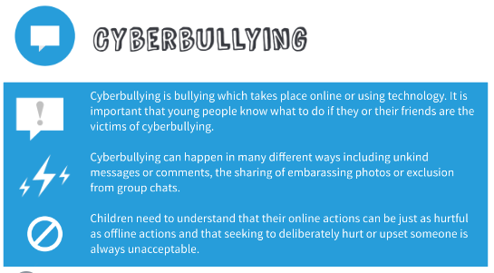

Slide 32
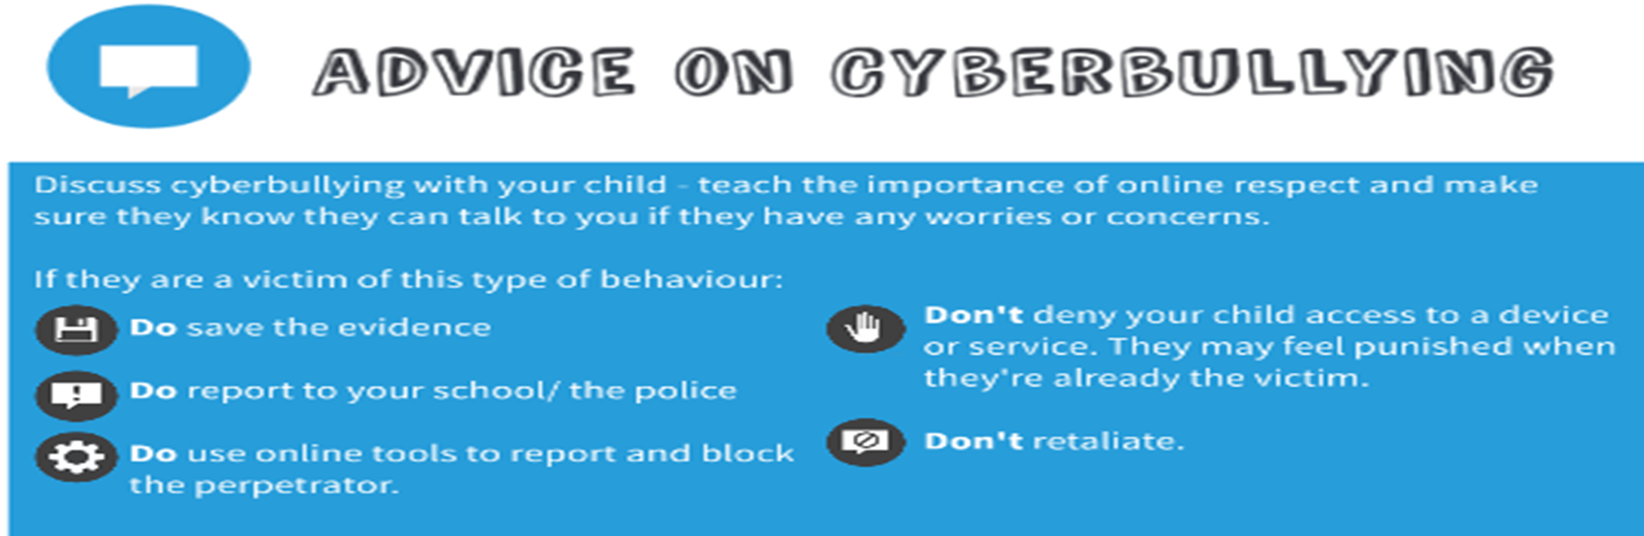
Shaming
Roasting
Trolling
Notes:
Roasting - – in which an image of a person is posted (either with or without their permission) and people are invited to criticise them. While this is viewed by young people as a form of ‘banter’ it is essentially cyberbullying.
Shaming - Is when a group of online, usually social media, users collectively attack a person or a company for their behaviour. The attacks are often insults, condemnations or threats to the victim of the attack. People can become quite self-righteous and put others down viciously. This type of online humiliation rarely justifies the supposed ‘crime’ and some of its victims’ lives have been ruined.
Trolling - This involves people fishing for conflict online. The troll’s bait is an inflammatory or bizarre comment, expertly designed to irritate people. They want people to respond to their remarks and to involve them in an infuriating, and pointless, argument. At best this behaviour can be viewed as banter – such as among rival football supporters. At worse, trolling targets have received death threats.

Slide 33
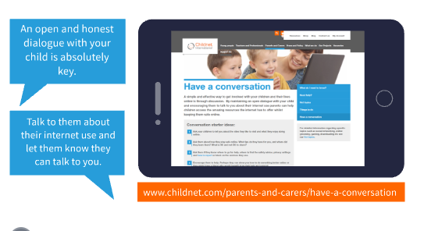

Slide 34
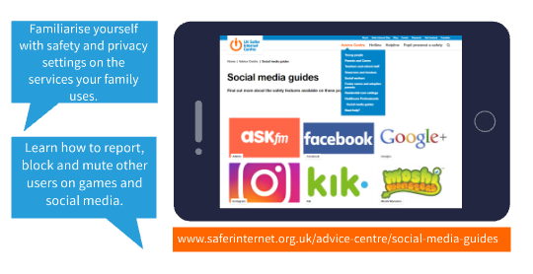

Slide 35
What is Meta Verse?
It’s all about connection! One of the main ideas of the metaverse is connecting everything all together. In theory, that means you’d be able to finish a game in Roblox and go onto ZEPETO without the need for changing devices or platforms. The goal for many is to make it so users can also connect with each other in meaningful ways within the online space. Video gaming, shopping, creating -- the metaverse would have it all!

Slide 36

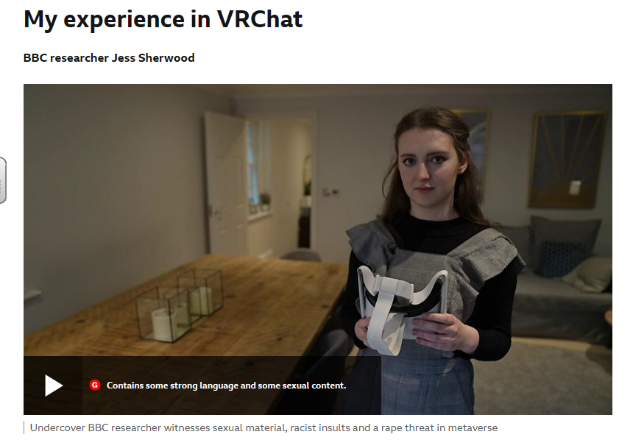
https://www.bbc.co.uk/news/technology-60415317

Slide 37

Tips to keep your child safe on VR Headsets.
Make the headset a family activity, taking turns and playing with it together.
Take some time to explore the headset before allowing a child to use it
talk to children about how they use VR.
Make sure they know that personal information should not be shared with people they don’t know get to know the safety features the device offers.
Make sure the location is set to private, use parental controls and check that privacy settings are switched on.
Set healthy boundaries and manage your child’s screen time.

Slide 38
Top tips for being safe online
• Be engaged! –Make space for talking about the online world from an early age
e.g. discuss their favourite emojis or YouTuber
• Be aware! – Make space for enjoying time online together
play their favourite games, visit their favourite websites and explore the online features of their devices
• Be there! – if something goes wrong
• Be thoughtful! – Make space for setting clear boundaries about tech use
help them to understand the difference between fact and fiction online

Slide 39
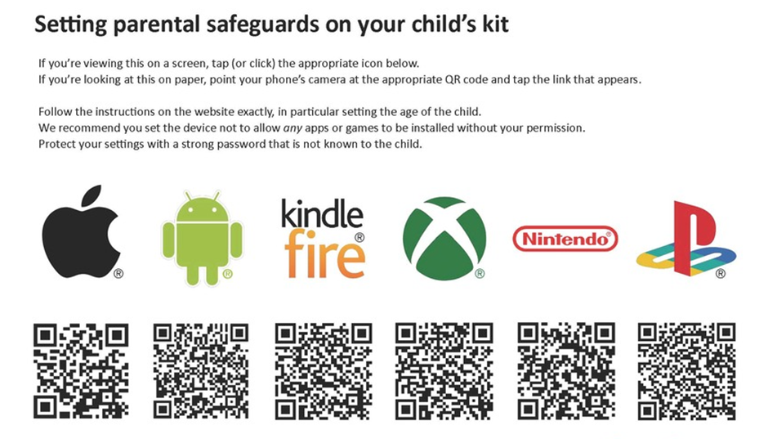

Slide 40
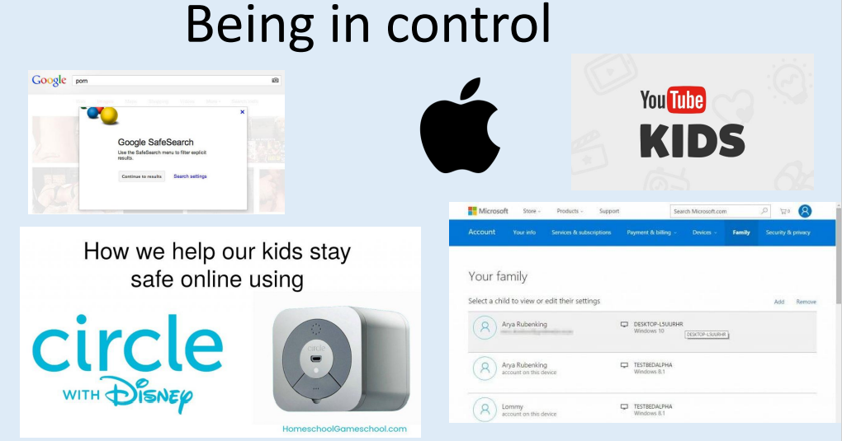

Slide 41

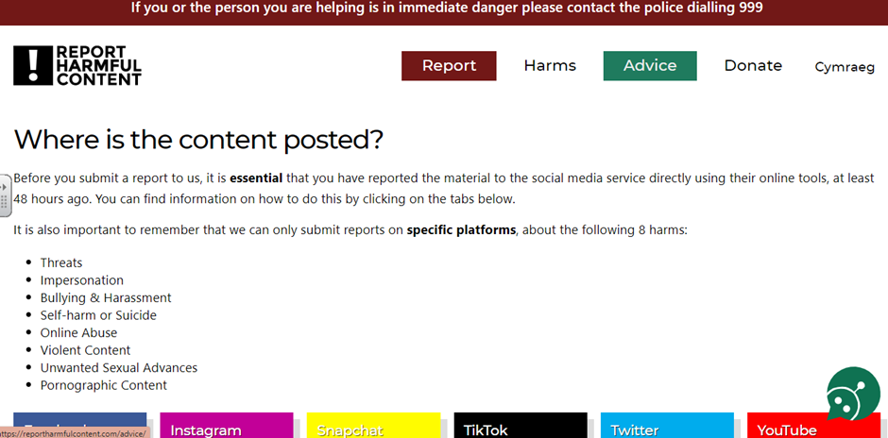
https://reportharmfulcontent.com/report/

Slide 42
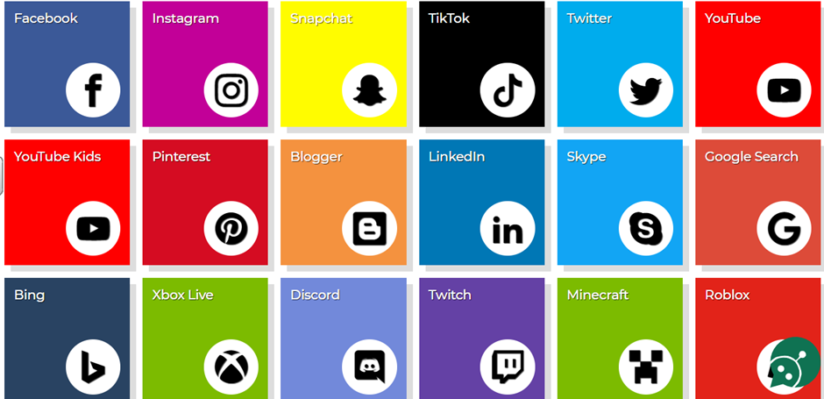
Notes:
Roasting - – in which an image of a person is posted (either with or without their permission) and people are invited to criticise them. While this is viewed by young people as a form of ‘banter’ it is essentially cyberbullying.
Shaming - Is when a group of online, usually social media, users collectively attack a person or a company for their behaviour. The attacks are often insults, condemnations or threats to the victim of the attack. People can become quite self-righteous and put others down viciously. This type of online humiliation rarely justifies the supposed ‘crime’ and some of its victims’ lives have been ruined.
Trolling - This involves people fishing for conflict online. The troll’s bait is an inflammatory or bizarre comment, expertly designed to irritate people. They want people to respond to their remarks and to involve them in an infuriating, and pointless, argument. At best this behaviour can be viewed as banter – such as among rival football supporters. At worse, trolling targets have received death threats.

Slide 44
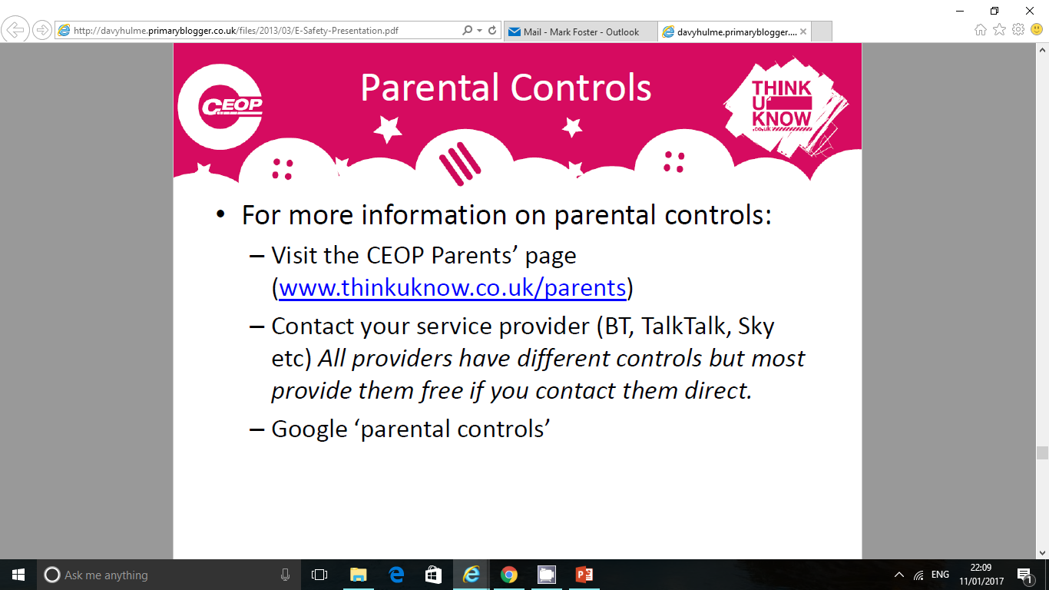
www.thinkuknow.co.uk/parents

Slide 45
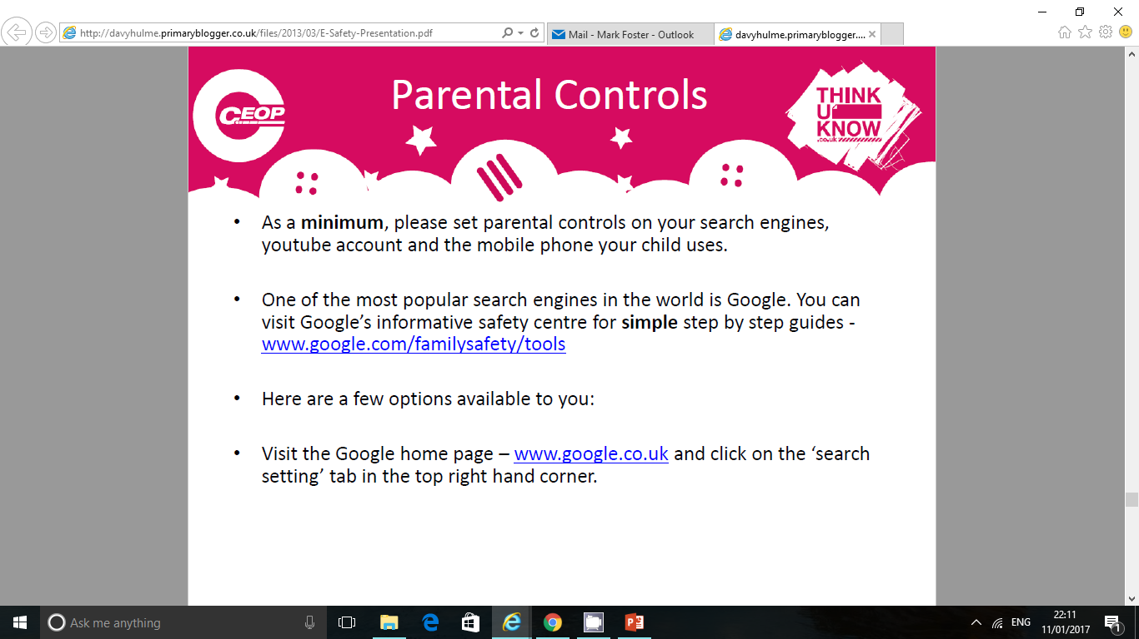
www.google.com/familysafety/tools
www.google.com

Slide 46
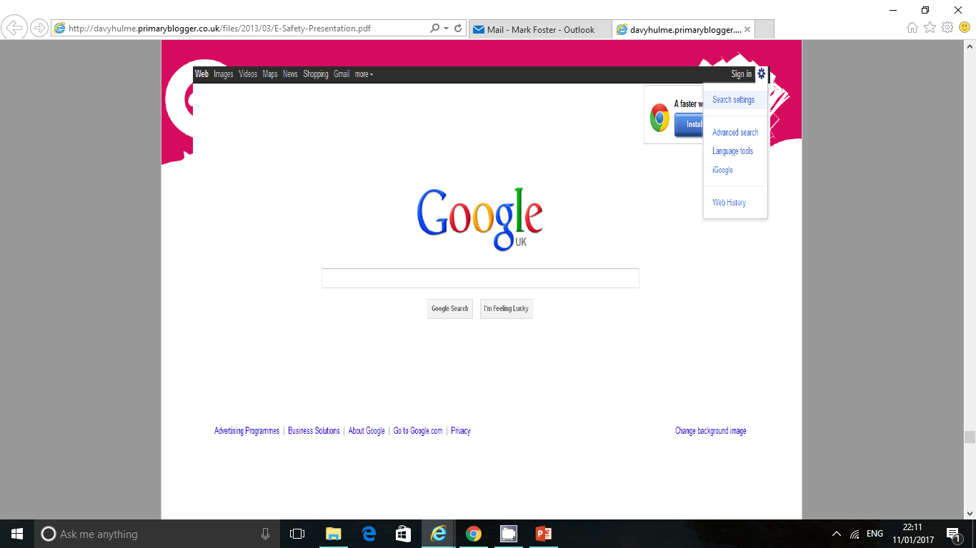

Slide 47
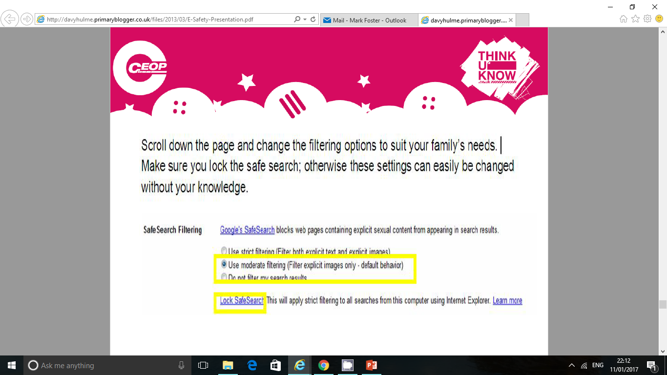

Slide 48
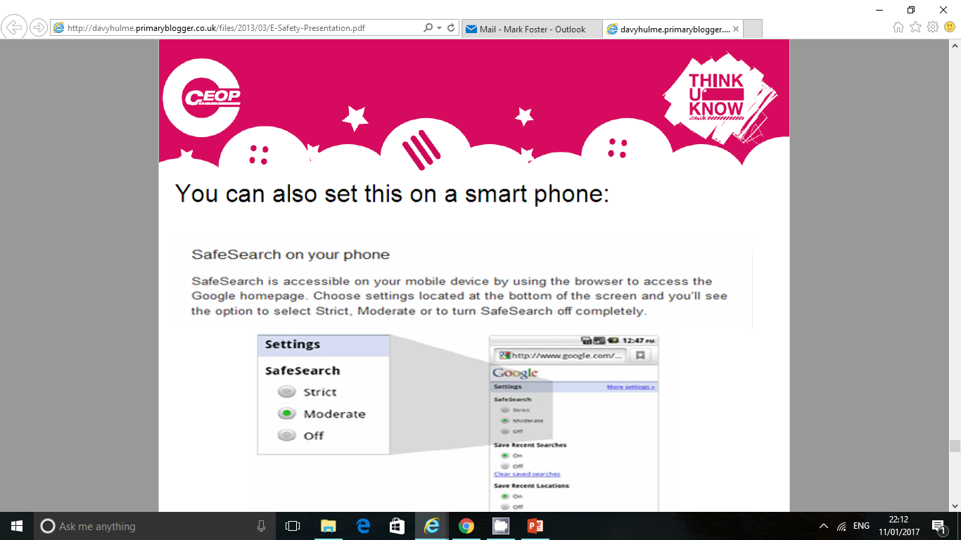

Slide 49
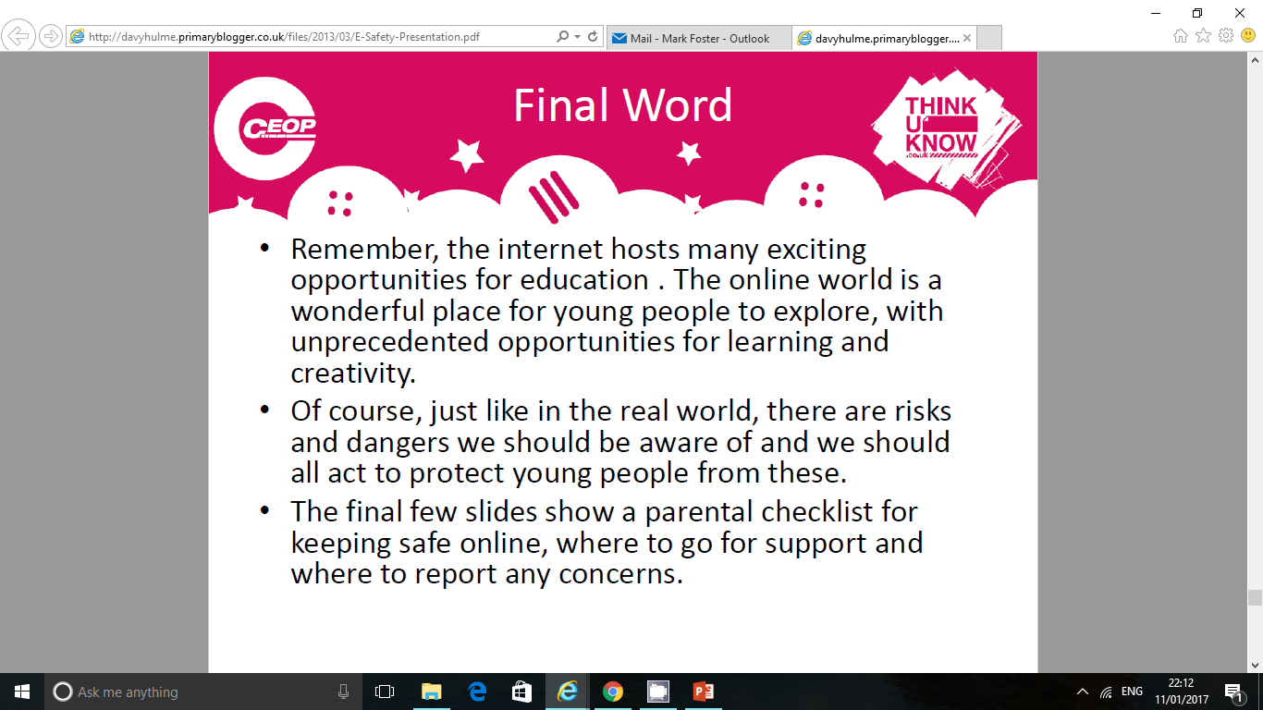

Slide 50
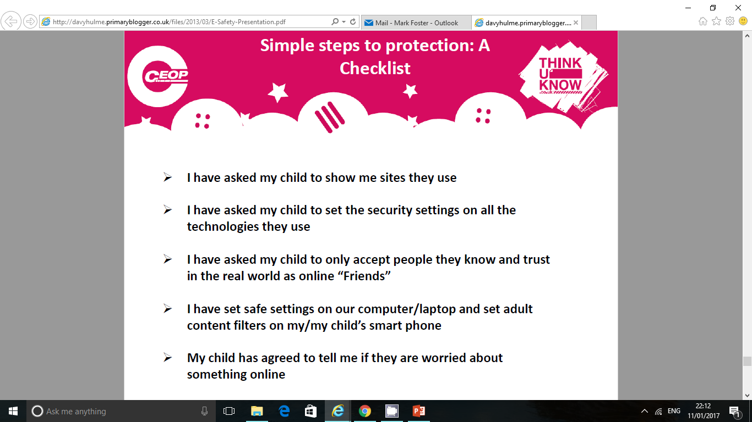

Slide 51
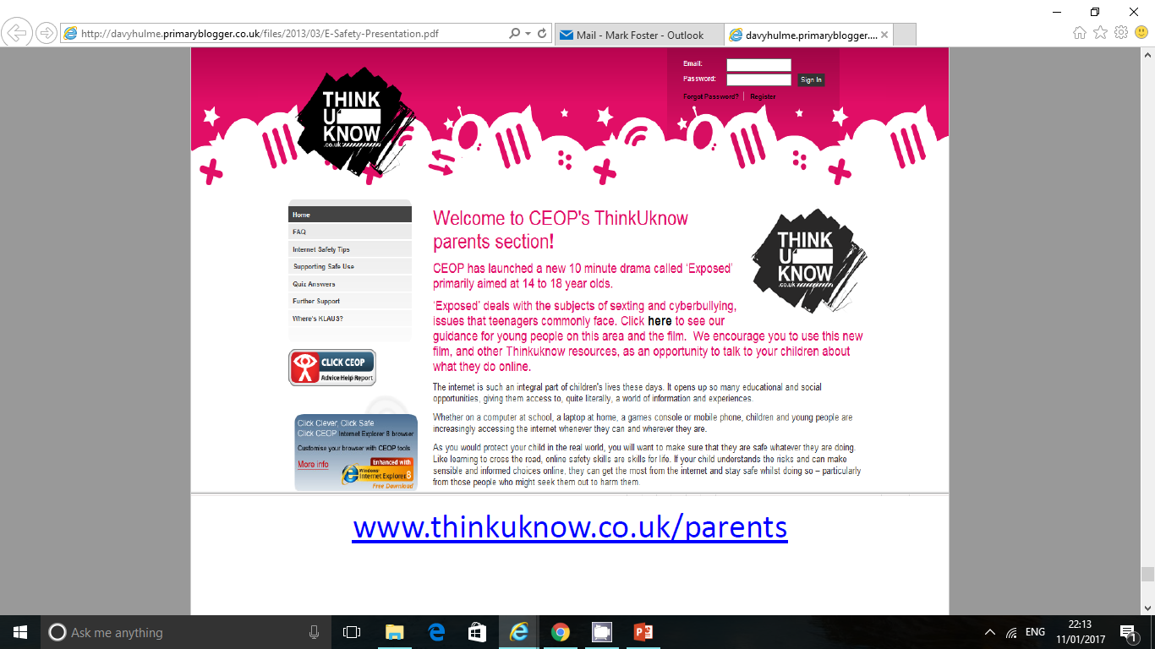
www.thinkuknow.co.uk/parents

Slide 52
Useful Websites
•
Internet Safety:
https://www.nspcc.org.uk/keeping-children-safe/online-safety/
www.thinkuknow.co.uk/parents
http://www.direct.gov.uk/en/Parents/Yourchildshealthandsafety/Internetsafety/index.htm
http://www.iwf.org.uk/
Facebook
http://www.facebook.com/safety/
TikTok
https://www.tiktok.com/safety/en/guardians-guide/
WhatsUp
https://www.safesearchkids.com/whatsapp-safety-for-kids/

Slide 53
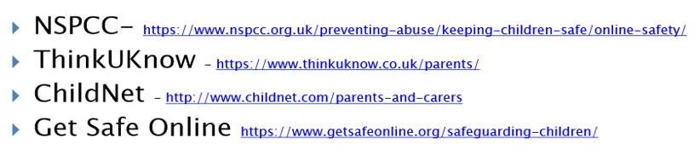
Useful Websites

Slide 54
Parental Control Software:
http://www.which.co.uk/baby-and-child/child-safety-at-home/guides/parental-control-software/
Useful safe websites for links across the curriculum, including games and general resources:
http://www.bbc.co.uk/schools/parents/
http://www.topmarks.co.uk/
http://www.woodlands-junior.kent.sch.uk/Games/
http://www.bgfl.org/bgfl/15.cfm?s=15&p=251,index
http://www.bbc.co.uk/schools/
http://durham.schooljotter.com/coxhoe/Curriculum+Links

Slide 55
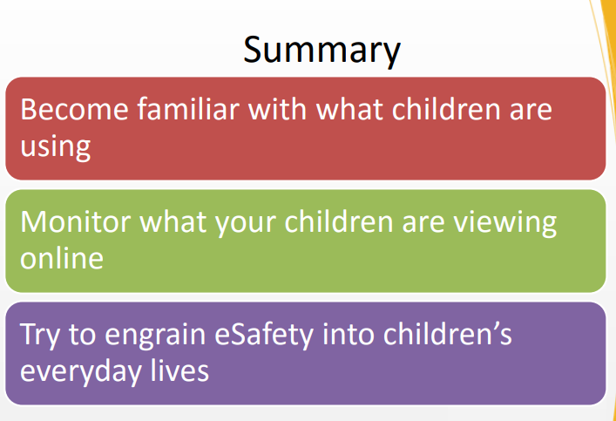
Useful Websites
•

Slide 56

Thank you for your time.
Together we can teach the children to be Online-safe.

