Slide 1
Malden Parochial Church of England Nursery School
An Introduction

Slide 2
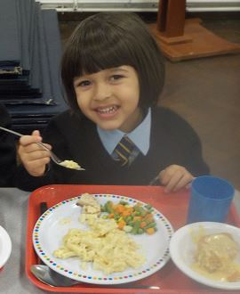
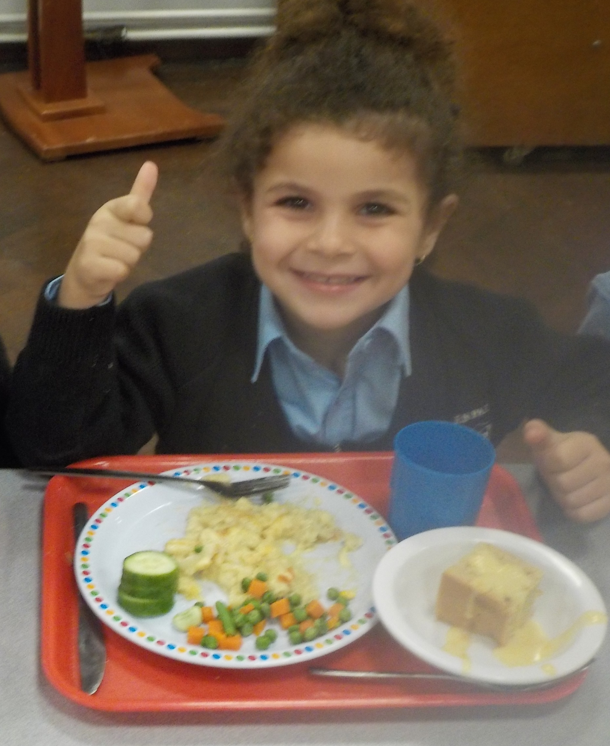
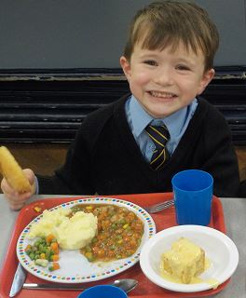
What options do we offer?
From January 2024 we will offer a choice of 15 or 30 hours (funded or self-funded) places to reflect the variety of childcare needs amongst parents in our area. The options available will be:
Part-time (15 hours) places, which will be for either 5 mornings (8.35am – 11.35am) or 5 afternoons (12.15pm – 3.15pm) each week.
Full-time (30 hours) places, which will cover 5 full days each week from 8.35am – 3.15pm. This includes a 40-minute lunchtime session per day which is not covered by the 30 hours funding for which a small fee of £7.50 per day is payable. This fee includes the 40 minutes per day of childcare and the cost of the school meal. If you would prefer to collect your child at the end of the morning session and bring them back for the start of the afternoon session after lunch, please speak to the school office.
Lunch club – depending on the number of full-time children in the nursery we offer a limited number of additional lunch club places available for parents who wish to extend their child’s part-time nursery session by 40 minutes per day to include a school meal. Children attending the morning session would stay till 12.15pm, and children joining the afternoon session would arrive at 11.30am. Each lunch club session costs £7.50 which includes a school meal.
All places are five days a week, term time only. The nursery is closed for all bank holidays and staff INSET days.

Slide 3
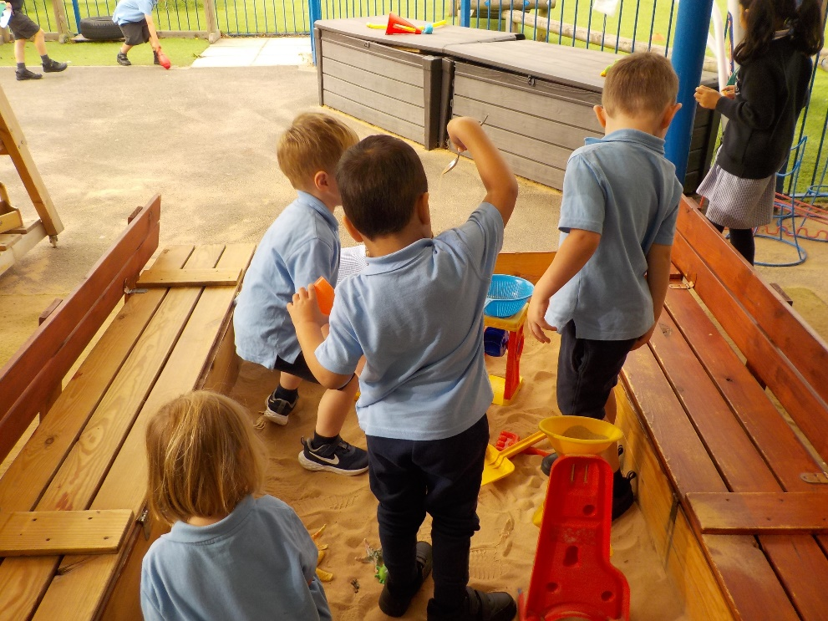
How will we help your child settle in?
Children thrive when they are loved and well cared for. We look forward to welcoming your child into our nursery and understand that for some children attending nursery for the first time will be daunting whilst others will take it in their stride. To make the process as smooth as possible we like to learn as much as we can about your child and use a range of strategies to help them settle in, including:
Questionnaires:
Once you have accepted your nursery place, we will send you a questionnaire covering your child's likes and dislikes, family and home environment, childcare history and routines, and child's health, medical and development needs.
Home visits:
In the days before your child starts nursery, our nursery staff will conduct a home visit to get to know your child in their own environment. This gives your child the chance to familiarise themselves with the nursery staff and gives you the opportunity to ask any questions and discuss any concerns.
Stay and play sessions:
On the first day, we will invite you and your child to visit the nursery together for a short session. This will give your child a chance to familiarise themselves with the environment and meet some of the other children.
Getting to know you activities:
During the first few weeks, the nursery staff will use a variety of small group and whole class activities to help the children build friendships.

Slide 4
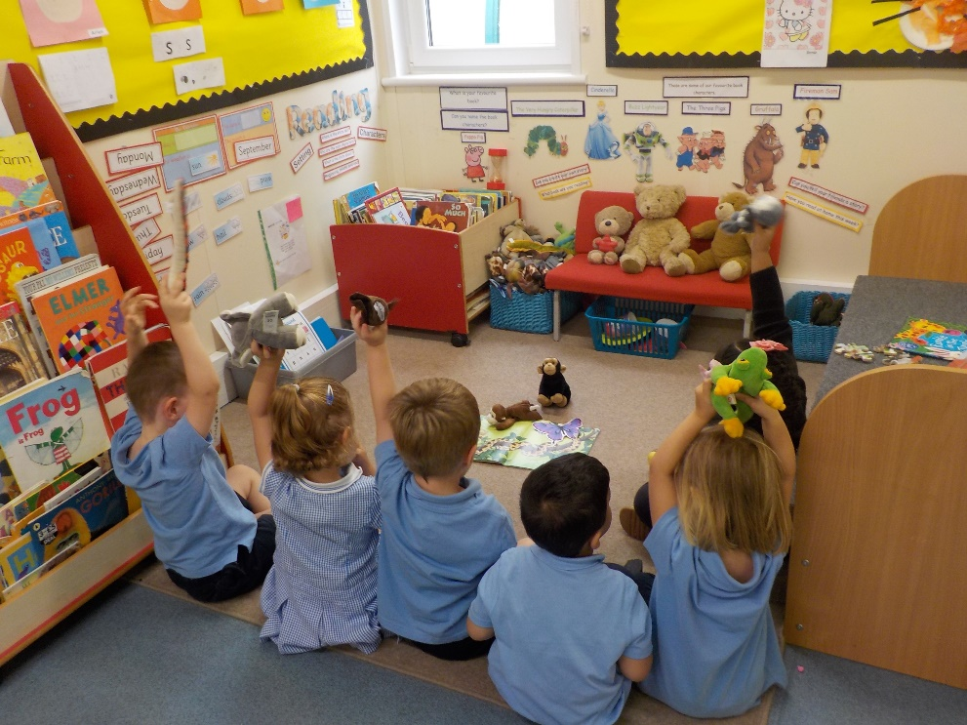
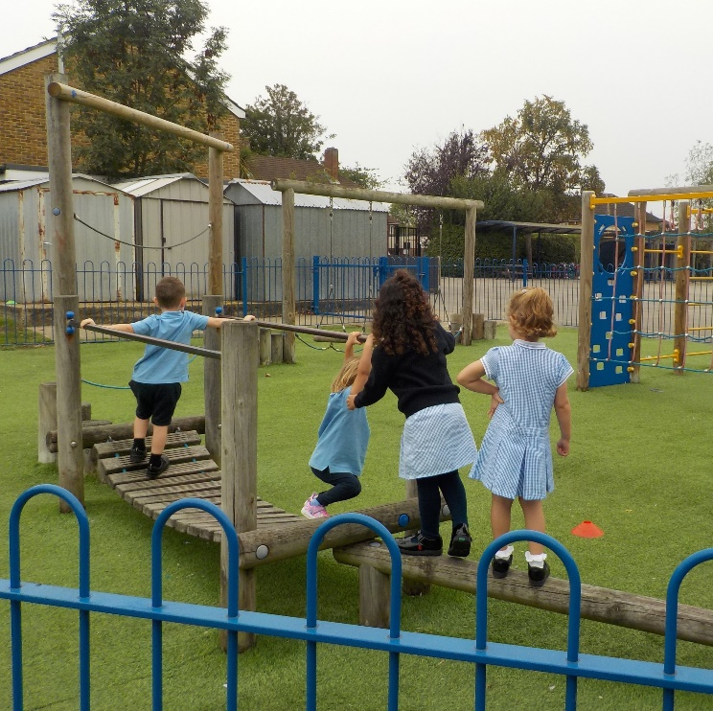
What to expect at Nursery?
A typical Nursery school day
8.35am | Arrival and registration
8.50am | Carpet time
9.30am | Free flow / small group learning
10.20am | Milk & snack time
10.35am | Free flow / small group learning
11.05am | Story time
11.35am | End of morning session / lunch time
12.15pm | Afternoon registration
12.30pm | Carpet time
12.45pm | Free flow / small group learning
2.45pm | Story time
3.15pm | Home time
Our Early Years Foundation Unit includes both Nursery and Reception and together they share a purpose-built building, separate from the main school, with a dedicated outdoor space.
The unit is staffed by two qualified teachers and supported by Level 3 qualified Early Years Practitioners.
Children learn through play, by adults modelling, by observing each other, and through guided learning and direct teaching.
Every child can make progress in their learning, with the right help.

Slide 5
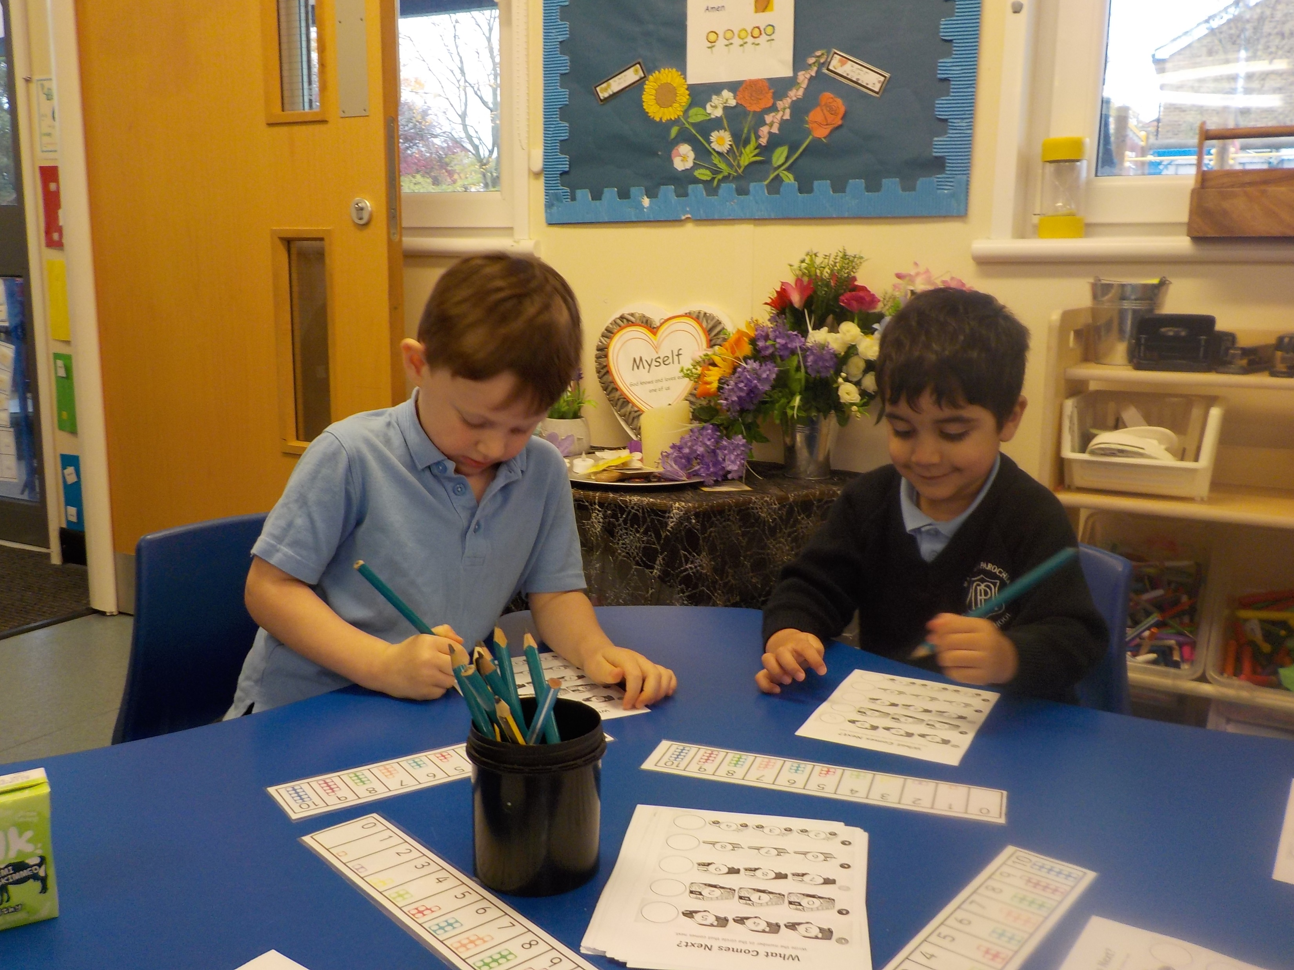
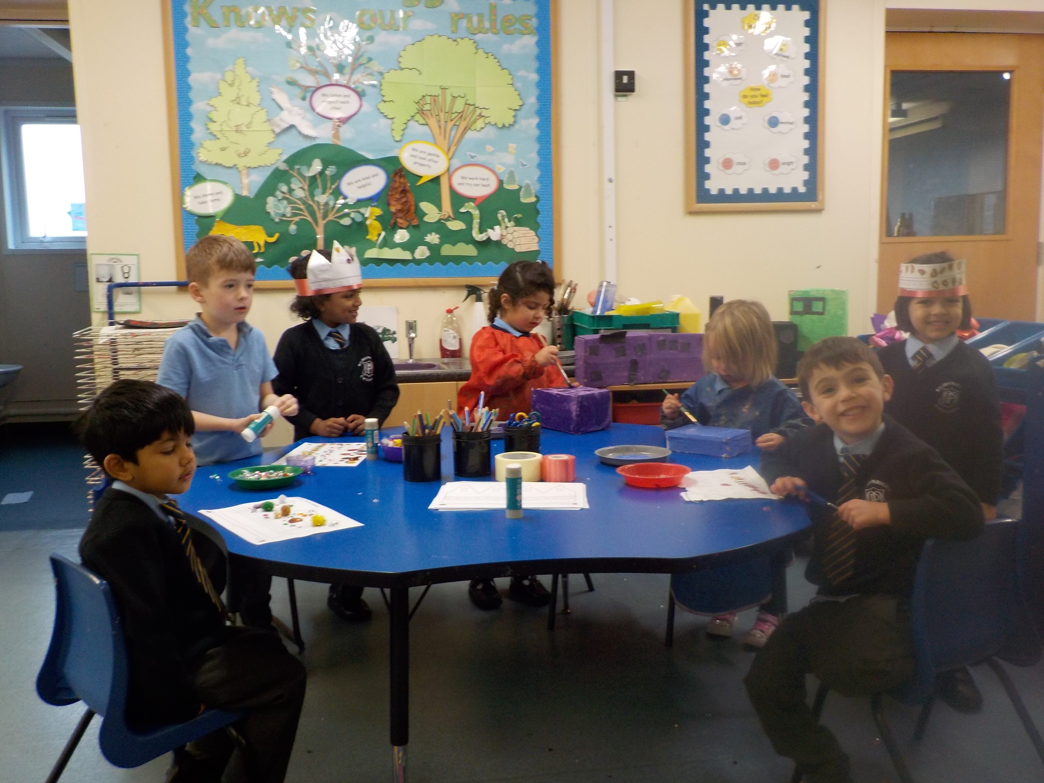
What will my child learn?
We follow the Early Years Foundation Stage (EYFS) Statutory Framework across both nursery & reception.
Our curriculum is ambitious, driven by the children's interests and carefully sequenced to help children to build their learning over time.
We provide a well-planned learning environment informed by how young children learn, what they like and what they need.
Your child will be learning skills, acquiring new knowledge and demonstrating their understanding through 7 areas of learning and development:
Personal, social and emotional development
Physical development
Communication & language
Literacy
Mathematics
Understanding the world
Expressive arts & design
Children in our Nursery get an excellent introduction to life at school, helping to prepare them for the transition to Reception.

Slide 6
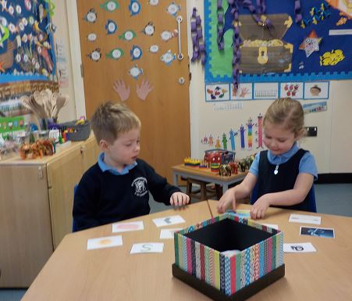
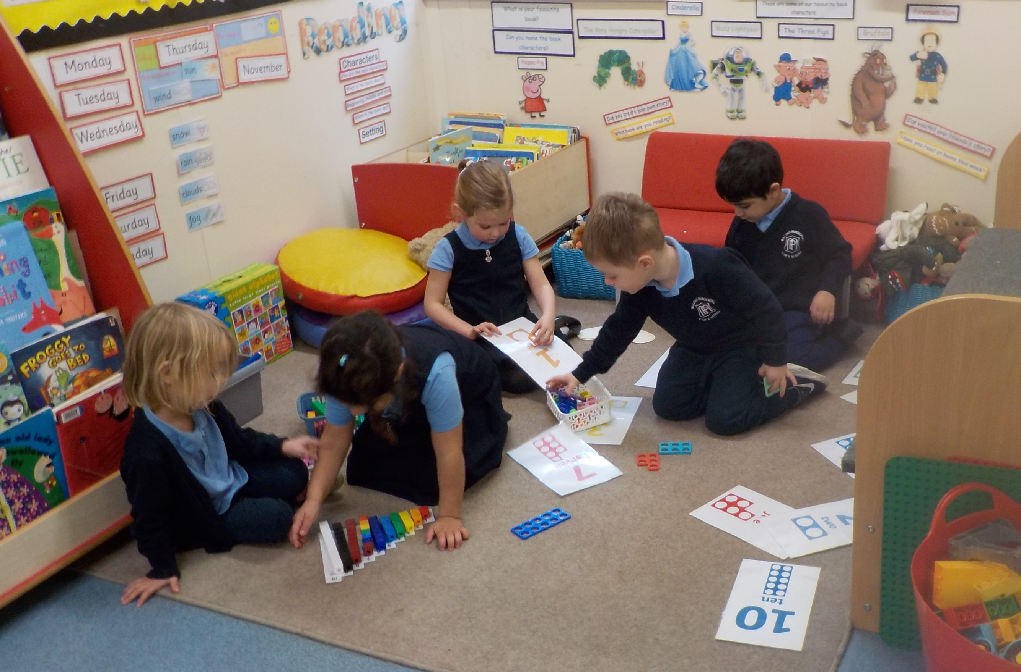
Early reading and maths
At Malden Parochial, children will get an early introduction to reading and maths.
We help the children to develop a love of reading and storytelling through:
Daily phonics lesson and phonic challenges.
Daily story time sessions in which we encourage the children to answer questions about the text.
Acting out the stories we have read and making up our own stories and sharing them with the class.
Singing nursery rhymes, reading rhyming books and playing rhyming games.
Playing games such as I spy, hangman, Pictionary, word search, scrabble, ladybirds, cheeky monkeys, and dragon race.
Vibrant book corner, full of good quality books and manipulatives to aid mathematical understanding.
Story books to share with parents at home.
We follow the Little Wandle Phonics programme, helping children to develop an early grasp of letters and sounds.
We work with children on number and letter recognition and support them to write by developing their pencil control and fine motor skills through cutting and drawing activities.

Slide 7
How will I know what my child has been doing at Nursery?
We keep parents informed of their child’s learning & development in a range of ways. These include:
Daily Discussions
Teachers from the Early Years Foundation Stage Unit are available at drop-off and pick-up every day.
Google Classroom
We use Google Classroom to share information about the children’s learning and to pass messages between parent and teacher.
Parent Consultations
Parents will be offered three parent / teacher consultations over the course of the year – a chance to discuss your child’s progress directly with their teacher - one in each term.
Learning Journeys
We keep each child’s activities in a Learning Journey and parents have an opportunity to review these at parent consultation evenings. These will be sent home to keep at the end of the academic year.

Slide 8
What wraparound care is available?
We offer a range of flexible and affordable wraparound care options, starting from 7.30am and running till 6pm each day. These are a combination of school run and third party run sessions, all of which take place within the school.
Breakfast club
Run by school staff
Drop-off from 7.30am daily
Healthy breakfast provided
Costs £7 per day
Booked via the school office and paid for half-termly.
After School Club
Run by a third party provider, Zone All Sports & Care
Runs until 6pm daily
Healthy hot snack provided
Costs £12.50 per day
Booked and paid for via the Zone All Sports & Care website.
Coming soon! Holiday club
Currently under negotiation with a third party provider
Hoping to be up and running by Easter 2024 (subject to OFSTED registration)
Will run from 8am to 6pm for 10 weeks of the year (5 weeks in Summer, 2 weeks at Easter and 1 week for each half term holiday).
Each of our providers are fully OFSTED registered and are staffed by suitably qualified childcare professionals as required by the EYFS framework.

Slide 9
What will my child need?
Nursery uniform:
Navy blue jogging pants or leggings
Pale blue polo shirt
Navy blue sweatshirt (school logo sweatshirts optional)
Navy blue pinafore dress (winter) or a blue gingham summer dress (from Easter till the October half term). This is not mandatory.
Socks / tights and comfortable shoes.
PE Kit:
Children in Nursery wear their usual uniform for PE.
Children will also need:
A Malden Parochial logo navy blue book bag
A waterproof coat for outdoor play
Adequate sun protection on hot days (sunhat plus parents should apply sunscreen)
A named water bottle full of water

Slide 10
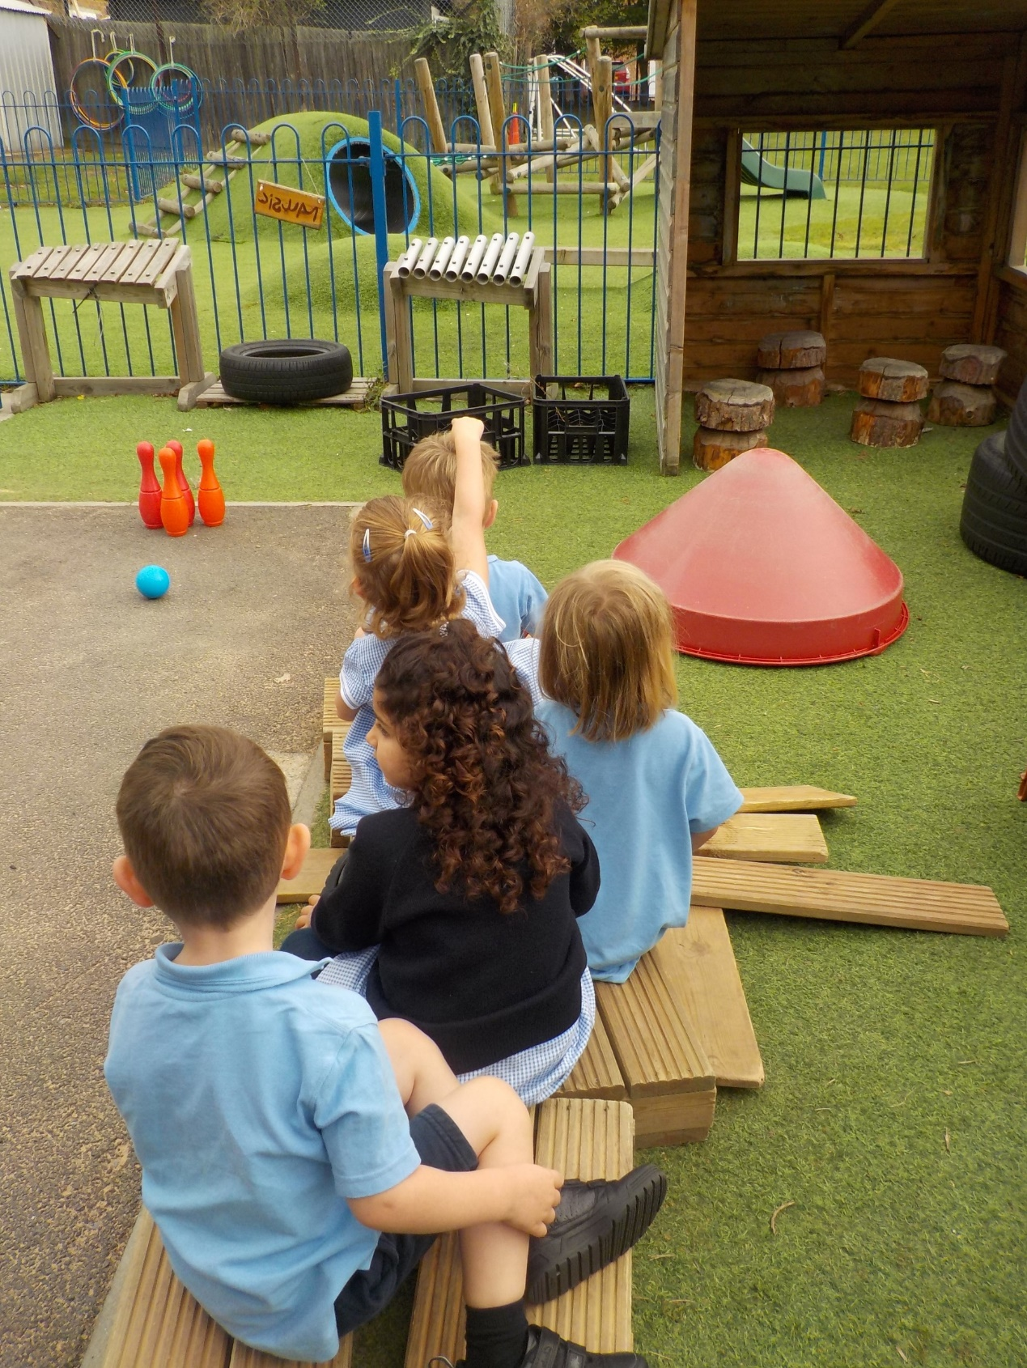
Why choose us?
Core sessions led by a qualified teacher
Experienced & trained support staff (Level 3 qualified)
Excellent transition to Reception – shared space and common curriculum
Dedicated EYFS building and outside space, with access to the wider school facilities
Older school children in the school as reading buddies
Free funded places available with affordable and flexible wraparound care
Coming Soon: Holiday club providing full-time care for 10 weeks of school holidays is currently being negotiated.

